Slide 1

E-Pharma services
Gulshan Yadav 20104085
Rahul Yadav 20104093
Mansi Viramgama 20104115
Mayank Viramgama 20104119
Project Guide
Prof. Shital Agarwal

Slide 2
Contents
Introduction
Objectives
Scope
Features / Functionality
Project Outcomes
Technology Stack
Block Diagram if applicable

Slide 3
1. Introduction
Problem Identified :
    Difficulty to find medicines from medicals during emergency
Solution Proposed :
    MedAlthea is a healthcare platform where you can immediate into medical shops in your vicinity

Slide 4
2. Objectives
To manage the details of medicines, stocks, medicals, etc.
To built at administrative end and thus only the administrator is guaranteed access.
To build an application program to tackle one’s emergency situation.

Slide 5
3. Scope
The scope of pharma services is high in the healthcare, medical, and marketing sectors.
• So this can be applied in Medical shops.
Here they can list their medicine with the help of a CSV file.
Manage their current stock and Update it.
Users will be helped to search there needed medicine with help of a map

Slide 6
4. Feature /Functionality
For accessing one has to Sign In and Sign Up
Multiple shops can be added.
Medicines can be added and updated.
Different Profile Section has been created.
Updated medicals and medicines are listed on the search page.

Slide 7
5. Outcome of Project
User can Search for Medicine.
If the medical owner has multiple medical shops he can add his shop.
Medicines can be added and updated and it includes information such as name of the medicine, Description, Price and Quantity of that particular medicine.
We have created different profile sections for both medical owner as well as for medical shops.

Slide 8





6. Technology Stack
  Django
  Rest framework
  Json Web Token
  Amazon DynamoDB
  PyQt5

Slide 9
7. References
python-graph-gallery.com/312-add-markers-on-folium-map
www.tutorialspoint.com/how-to-get-the-longitude-and-latitude-of-a-city-using-python
docs.djangoproject.com
doc.qt.io

Slide 10
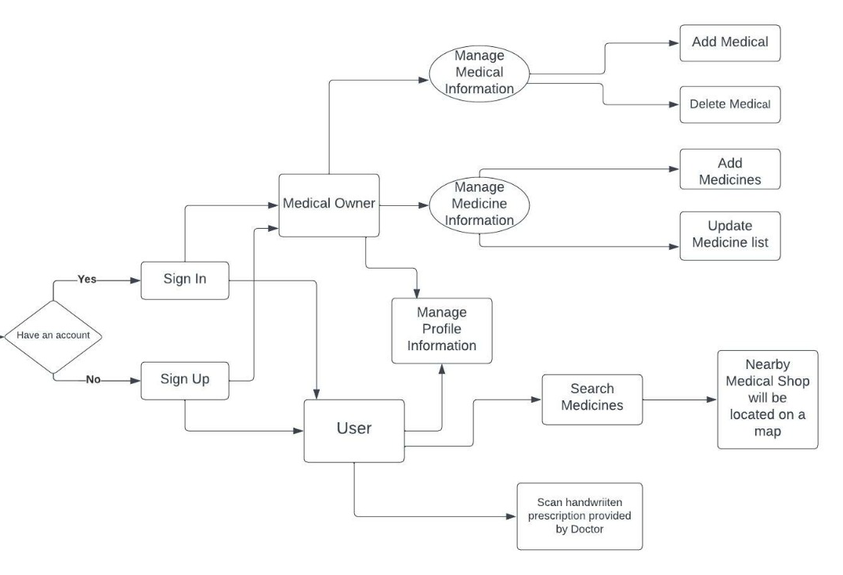
8. Block Diagram

Slide 11
Thank You...!!

